Slide 1
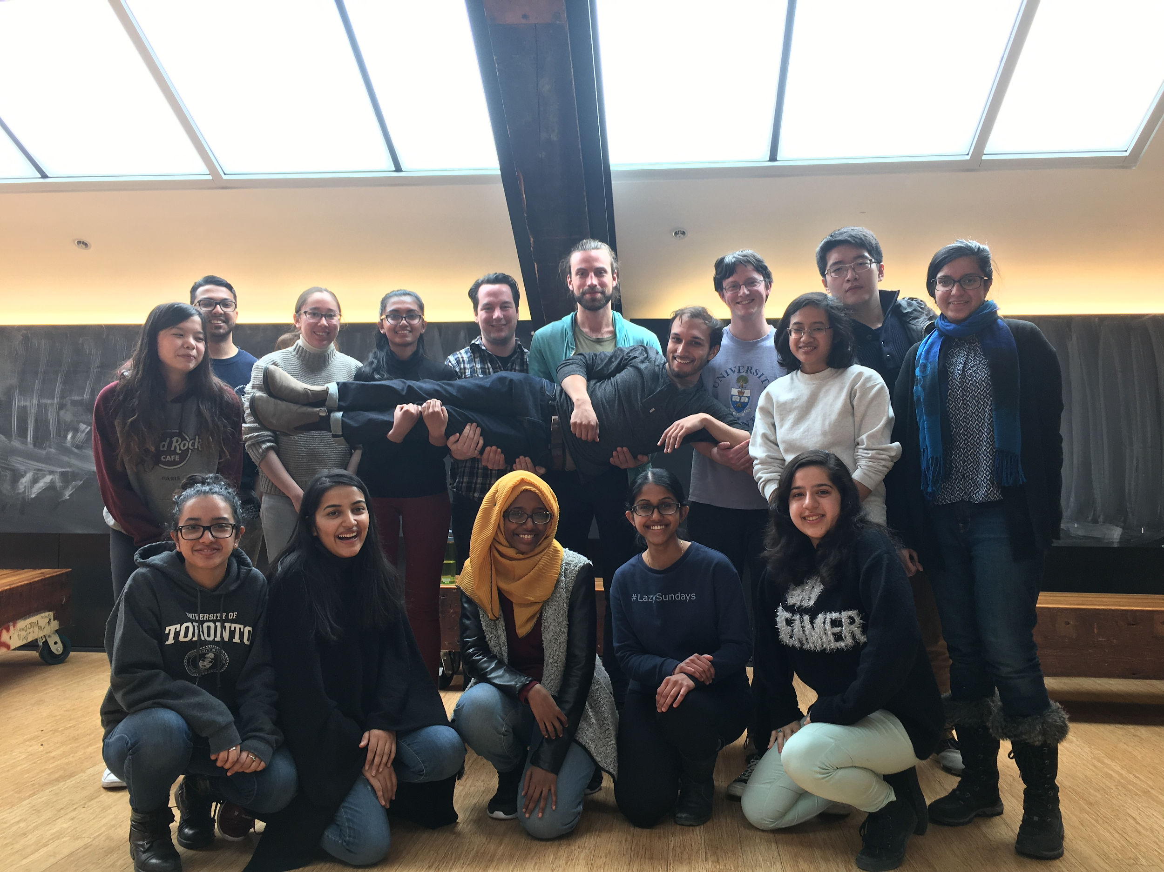
Before we start
Please mute yourself (for now) 🔇
You’re encouraged to turn your camera on, but it’s ok if you can’t! 📹
Display your name + pronoun
Hover your cursor over the window with your face
Click on the three dots in the top right corner
Use the “Rename” function to display your preferred name and pronouns
In the chat (centre, bottom of screen) share your name and program 💬

Slide 2
WELCOME to the
Community Engagement Workshop

Slide 3
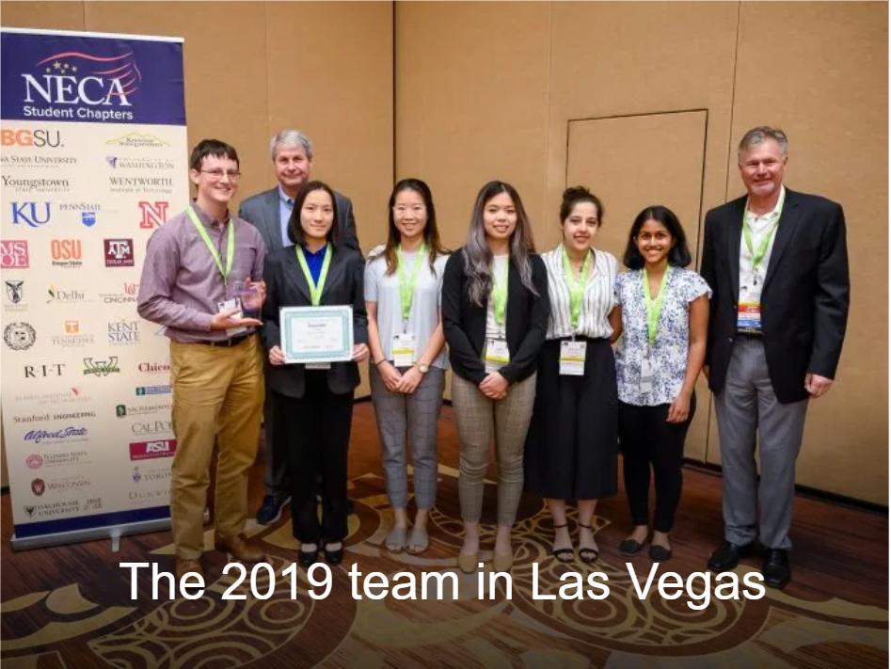
What is CECA?
Multi-Disciplinary Design Team
Provide workshops on sustainable building energy
Participate in Green Energy Challenge (design competition)
Provide opportunities: network with industry professionals; use softwares to help audit and evaluate building performance

Slide 4
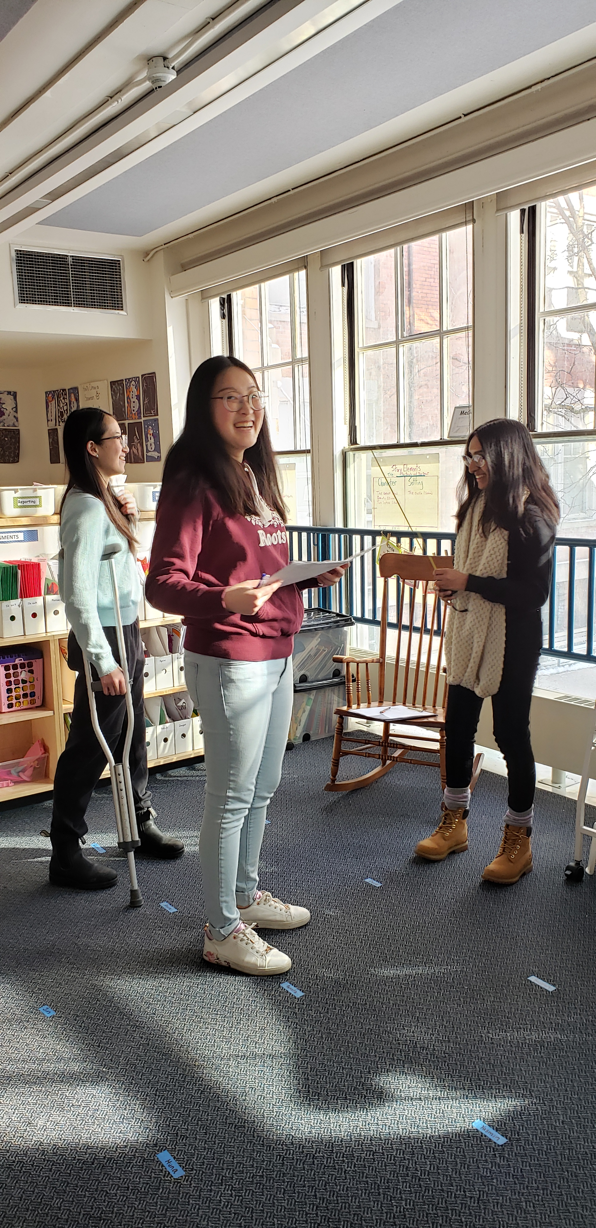
breakdown
Brainstorm
Plans or campaigns that addresses sustainability, energy savings
Building credentials as inspirations
Discussion!

Slide 6
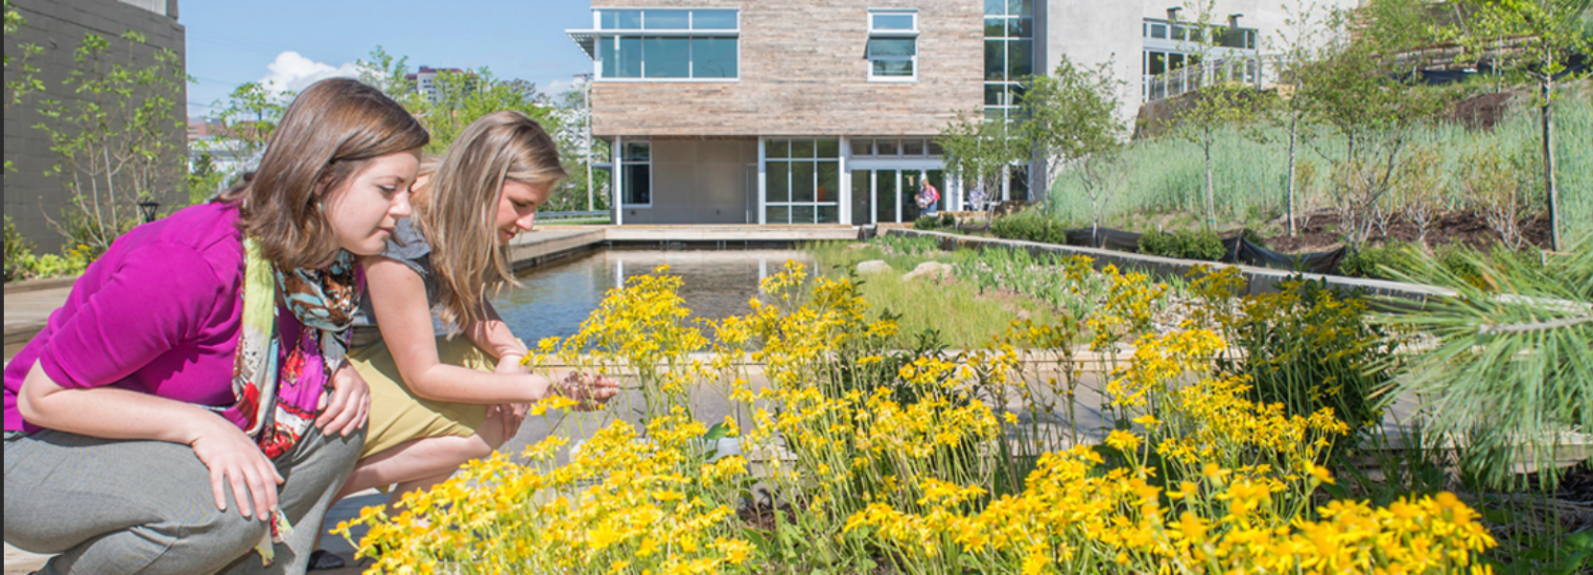
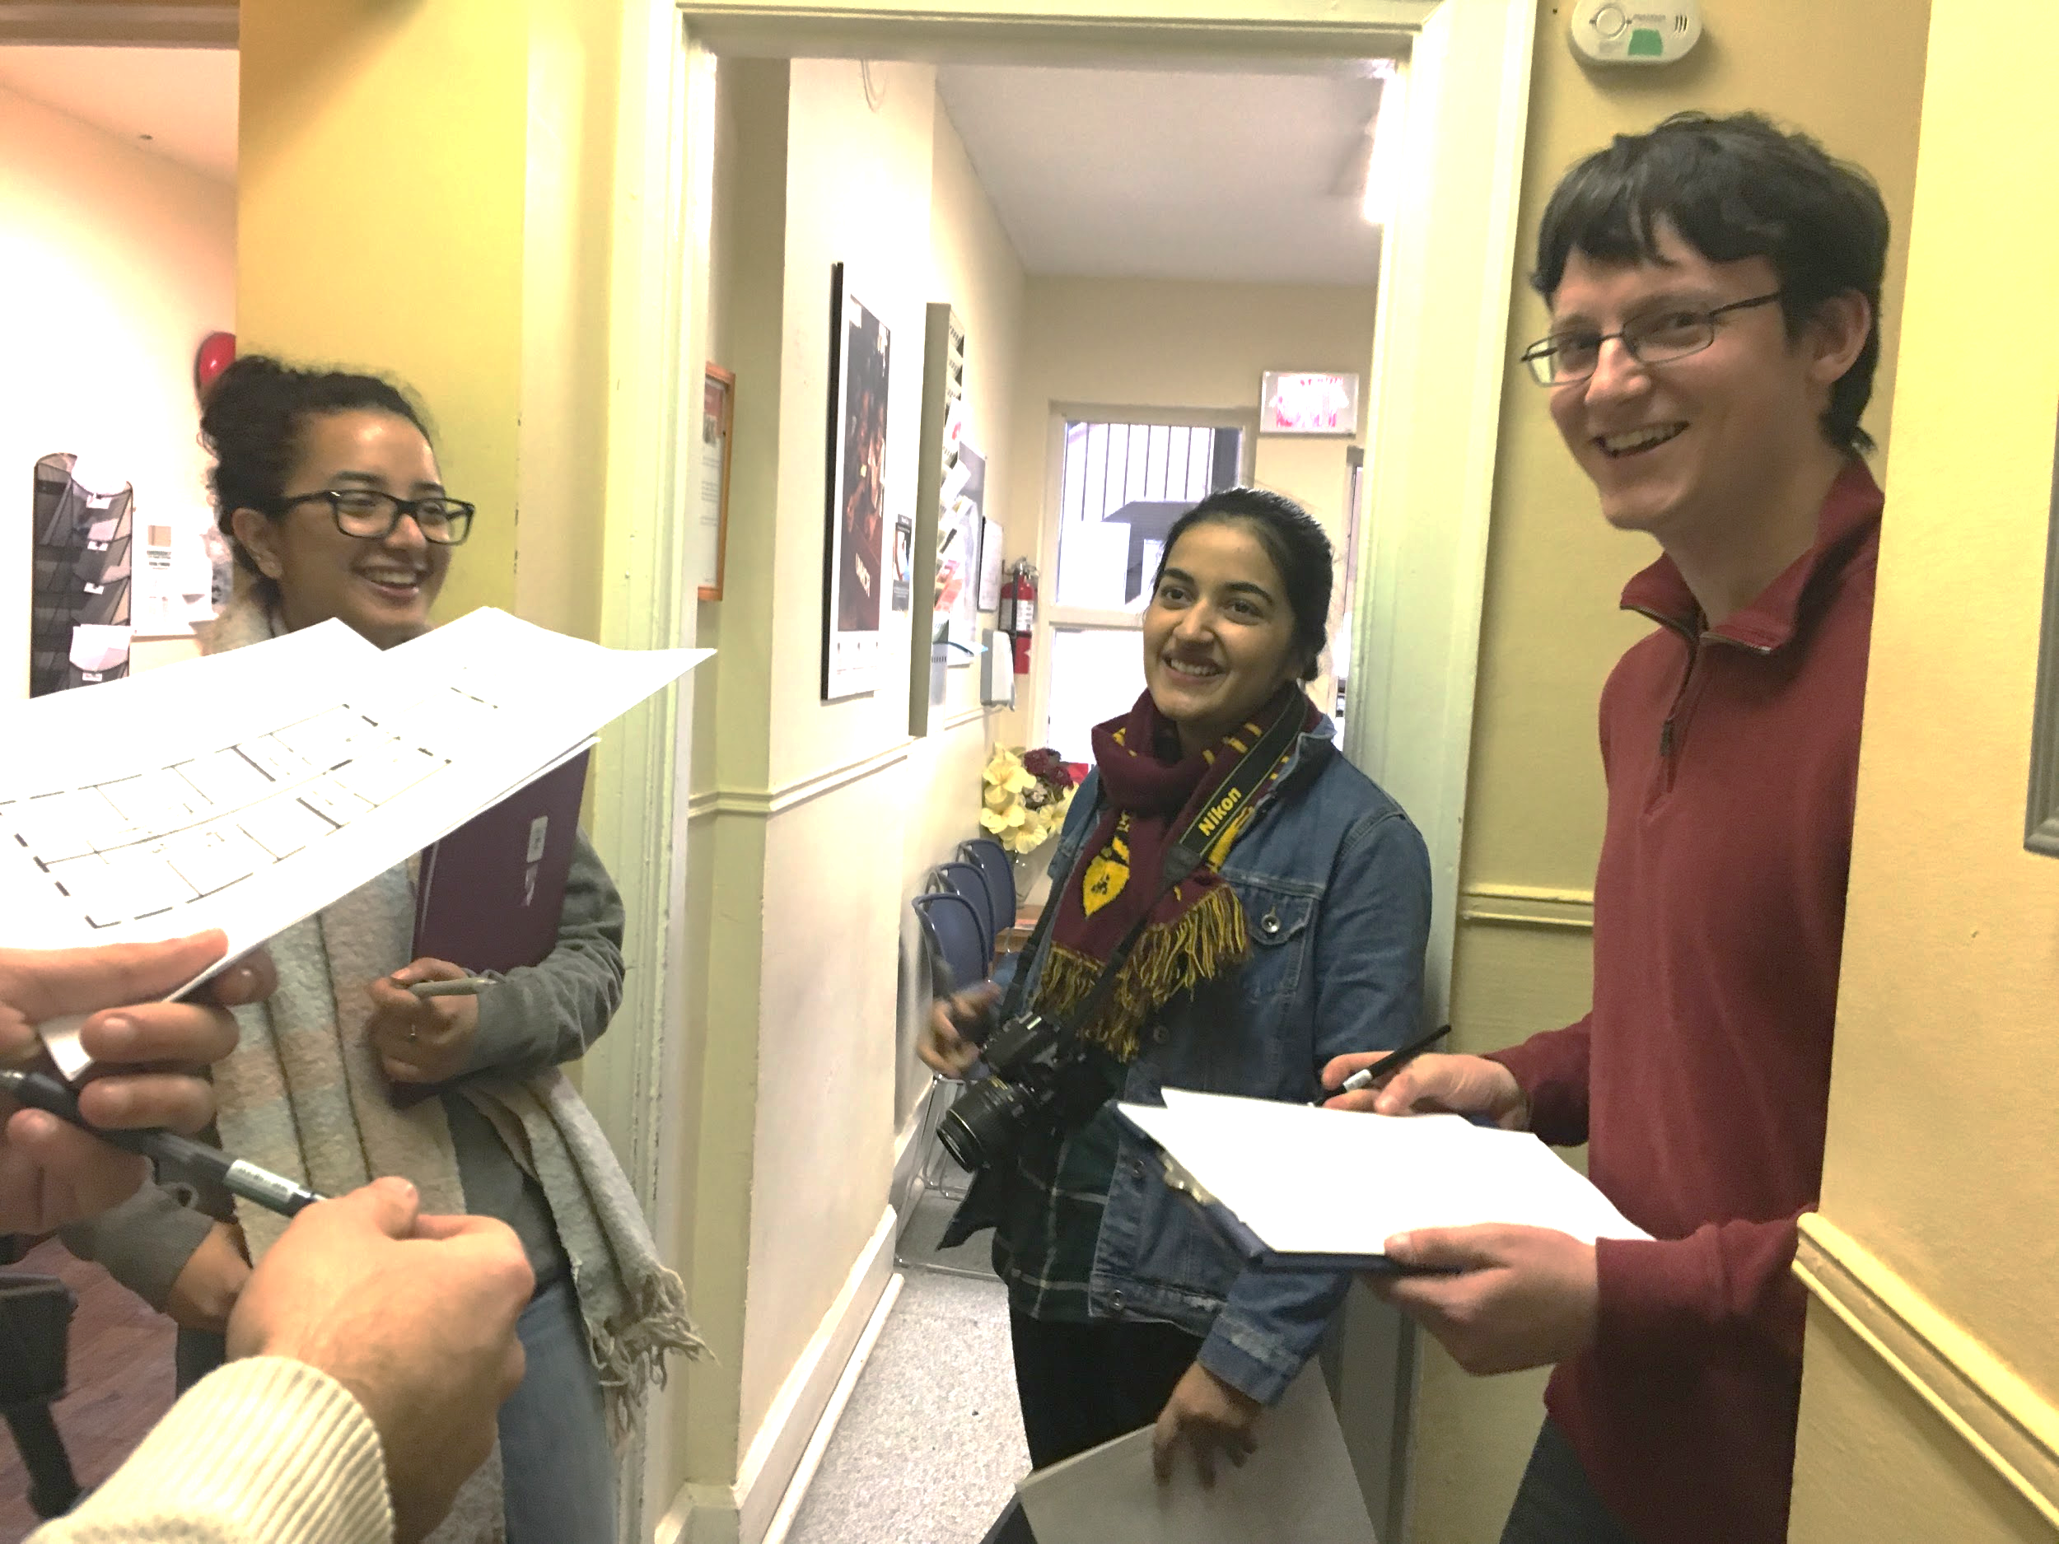
why we do it at a retrofit project?
For Occupants
further energy reduction
For Community
Learning culture
community identity and social cohesion
For
Yourself
required in GEC

Slide 7
Step1) goal setting
What is currently missing?

Slide 8
Step2) brainstorming - WELL
what is it?
-building Credential
-places human as
priority
Notes:
What is WELL? -WELL Building Standard harnesses built environment as a vehicle to support human health, well-being and comfort, lead to improved nutrition, fitness, mood, performance of its occupants
- This is achieved by implementing strategies, programs and technologies specially outlined in the 105 features from the 7 categories in the diagram.

Slide 9
Step3) narrow down - WELL
Each features are interconnected and helps us brainstorm outreach program.
Notes:
-An example of a technical feature can be regulation for newly interior paints and coatings to meet standards to reduce VOC (volatile organic compound) that includes benzene, formaldehyde and other chemical compounds. Additional air features are demand control ventilation, air flush, filtration, construction pollution management and so on.
-For water category, it focuses not only on treatment but also promotion on drinking water
-for comfort category, major focus is on thermal comfort that relates to HVAC syste,
-For nourishment, it includes mindful eating (having enough space to eat), food production on site, supply of fruit and vegetables and so on.
-For light, the design includes low-glare and daylight modelling, circadian rhythm that fits people’s sleep schedule
-for fitness, it specifies number of equipments and outreach promotions
-Interestingly, for mind category, one of the feature is altruism, pychologists posit that volunteering fulfills numerous social functions: it provides a way for people to express their values, can provide career-related experiences, strengthens social relationships

Slide 10
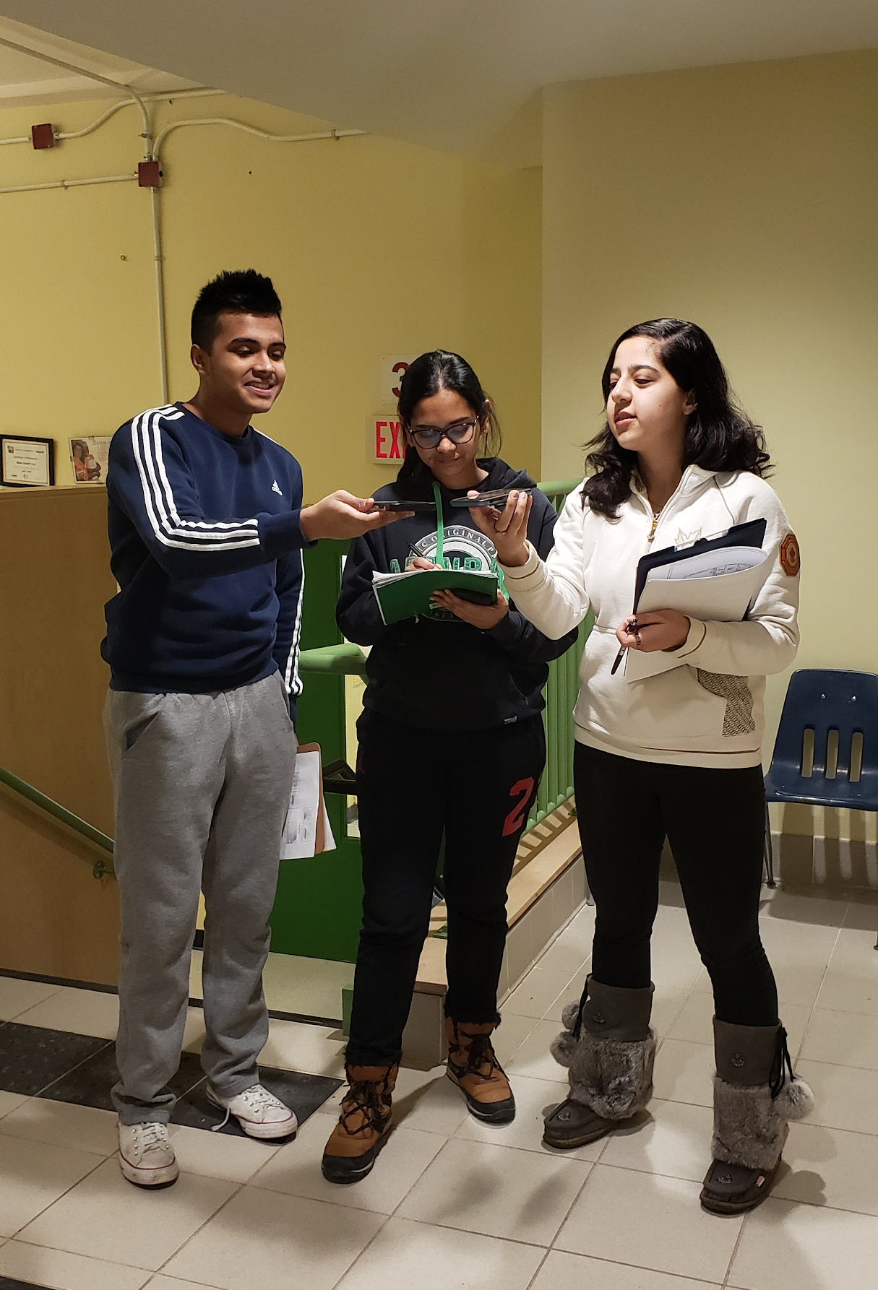
Step4) start planning！
In breakout sessions (10min):
Imagine you and your team members are planning for a series of volunteering activities to help a group of middle school students understand the importance of sustainability during COVID-19 (i.e. no in-person events)
What plans will you come up with?
How can you make sure students stay engaged and learn?
Be as detailed as you can!

Slide 11
Step5) getting feedback!
Challenges: what are you unsure of?
Innovation: what are some ideas you come up with?

Slide 12
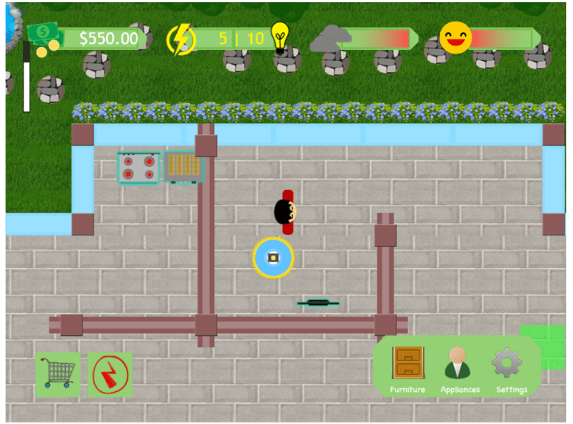
What we did this year
two sets of curriculums
-with focuses on energy, material and wellness
Online game
Videos
-elementary and secondary levels
Handouts
-sent along with videos
Notes:
-accessible, fit different group needs
-Elementary: concept of energy with everyday examples, identified renewable versus nonrenewable sources.
Activity: word search, energy appliances coloring sheet, and an energy Pictionary game.
intermediate level, the lesson explained the relation between energy and electricity with an animation to discuss the principle behind
building materials highlighted the importance of life cycle assessment and ways to evaluate the environmental impacts and cost of materials.
Elementary: sudents were introduced to how wood, brick, glass, and steel for different
components of a house are manufactured.
Intermediate: material selection based on aesthetics, structure, thermal/moisture control, and air barriers.
emphasized the interconnectedness of building design on human wellbeing regarding air quality, thermal comfort, and workspace. Both ended with tips for students to maintain a healthy mind and body in indoor environments. For example, the elementary students were given a mindful bingo activity to try during quarantine to practice self-care and stay connected socially with family members, friends, and the local community.

Slide 13
Case 2
What can you tell based on the info below?
Resident: I have lived with my family at CRWC for over a year. We have grown close with other families and our children made great friends. We are very grateful for the strong sense of community here because it made our transition to a new life in a new country a lot easier. One thing we learned here was how important it is to do our part to conserve energy everyday. We have gotten into the habit of turning off the lights during the day and unplugging appliances when they are not in use.

Slide 14
Case 2
What can you tell based on the info below?
What are some possible topics to build on?
Resident: I have lived with my family at CRWC for over a year. We have grown close with other families and our children made great friends. We are very grateful for the strong sense of community here because it made our transition to a new life in a new country a lot easier. One thing we learned here was how important it is to do our part to conserve energy everyday. We have gotten into the habit of turning off the lights during the day and unplugging appliances when they are not in use.

Slide 15
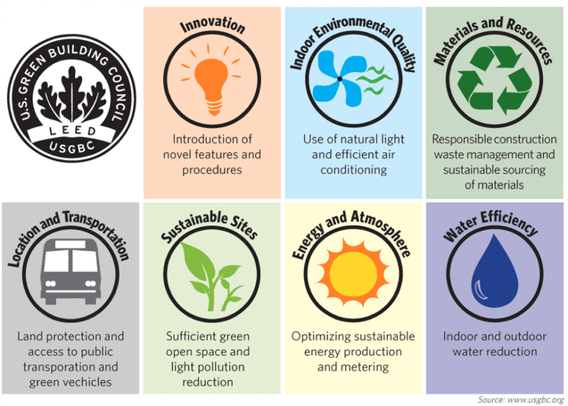
Step5) more research- LEED
what is it?
-building Credential
-places environment
as priority
Notes:
Leadership in Energy and Environmental Design (LEED) is a green building certification program used worldwide. Developed by the non-profit U.S. Green Building Council (USGBC) it includes a set of rating systems for the design, construction, operation, and maintenance of green buildings, homes, and neighborhoods which aims to help building owners and operators be environmentally responsible and use resources efficiently.

Slide 16
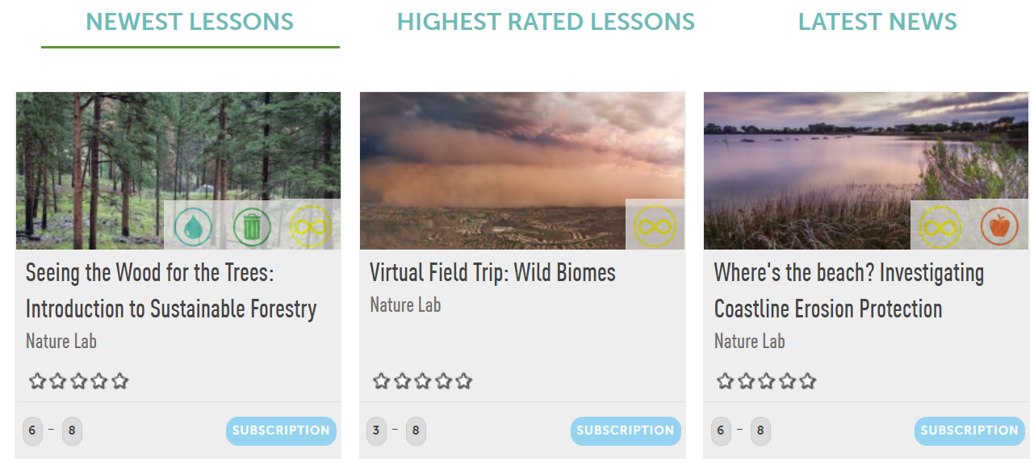
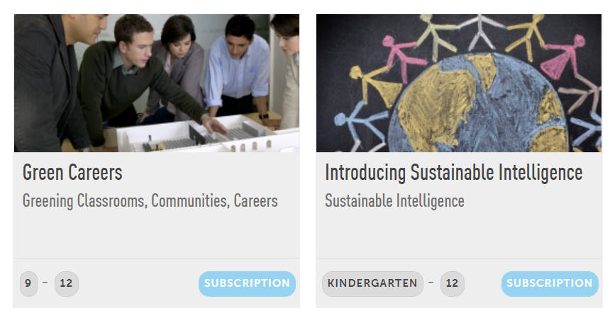
Some Tools
For brainstorming: Miro
For sustainable education: LEED Learning Lab

Slide 17
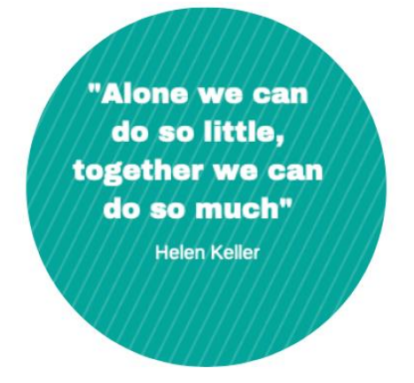
Take-away & Reflection
Spend time to know the ‘users’
set a vision and a goal that excites you
Be interactive!
create an open space for learning (online and offline)

Slide 18
Questions?

Slide 19
THANK YOU
for Coming to our workshop
Remember to...
Sign Up for our Newsletter!
Check Out our Website: cecauoft.skule.ca
Follow us on our Social Media Accounts!
Facebook: CECA U of T Student Chapter
Instagram: cecauoft
LinkedIn: CECA UofT

